Slide 1
AI Smart Queue Management
Presenting By:
V.Rakshitha

Slide 2
PROBLEM STATEMENT
Long queues and overcrowding in public places like hospitals, banks, and railway stations.
No real-time system to track queue length or estimate waiting time.
Leads to confusion, time wastage, and poor crowd management.

Slide 3
OBJECTIVE
To detect and count people in queues using AI and Computer Vision.
To estimate waiting time and monitor crowd status in real time.
To improve queue management and reduce waiting time in public places.

Slide 4
TECHNOLOGY USED
Python (Programming Language)
OpenCV (Computer Vision)
HOG + SVM (People Detection)
pyttsx3 (Voice Output)
NumPy (Data Processing)

Slide 5
SYSTEM WORKING
The system captures live video from a webcam or CCTV camera placed in the queue area. Each video frame is processed using OpenCV and a HOG-based AI model to detect and count people in real time.
Based on the number of people detected, the system calculates waiting time and determines queue status such as Normal, Busy, or Overcrowded.
The system provides smart recommendations like moving to the next counter when the queue is long. Voice output is generated to announce queue status, waiting time, and instructions to users.

Slide 6
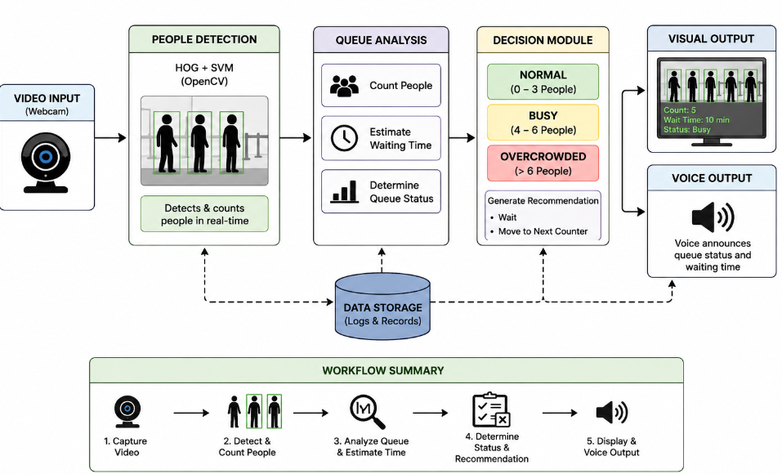
SYSTEM ARCHITECTURE

Slide 7
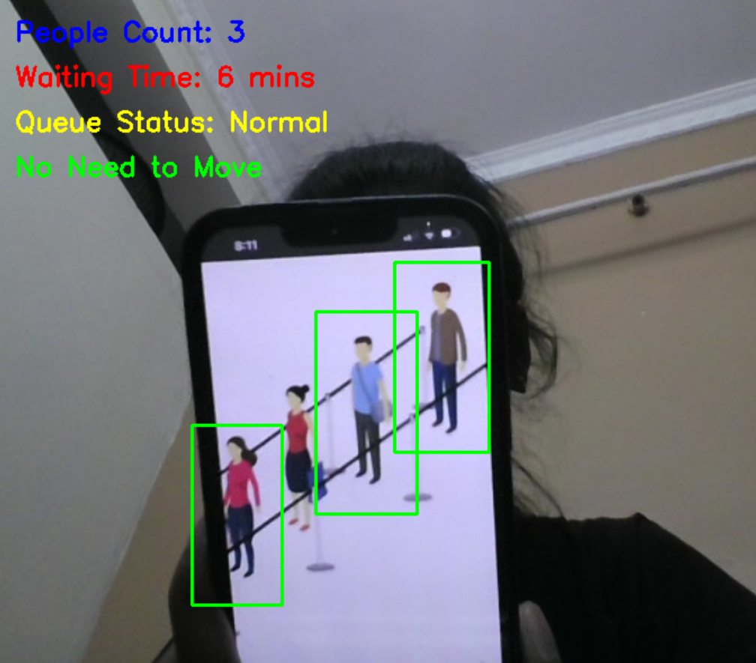
OUTPUT

Slide 8
CONCLUSION
The AI-Powered Smart Queue & Crowd Intelligence System successfully demonstrates an efficient way of managing queues using Artificial Intelligence and Computer Vision. The system is capable of detecting and counting people in real time, estimating waiting time, and providing queue status updates such as Normal, Busy, or Overcrowded.
It also improves user experience by giving smart recommendations and voice-based announcements, which help reduce confusion and waiting discomfort. This project shows how AI can be effectively applied in real-world environments to improve crowd management, reduce waiting time, and enhance overall service efficiency in public places.

Slide 9


